Slide 1

Multiple CPU Systems
Overview and Operation
Use of Caches and Arbitration for Main Memory
IO Arbitration
Mutual Exclusion for IO Devices
Test and Set Instruction (TAS)
Hardware MUTEX
Main Memory Coherency and Cache Bypassing
Note: After today, please read lectures 26A and 26B on Canvas
©Paul Davies. Not to be copied, used, or revised without explicit written permission from the copyright owner.
This lecture may contain animations and is best viewed as a slide show

Slide 2
With a cache, our CPU is no longer limited to running 100% from main memory.
A cache frees up main memory bandwidth for multiple CPUs to share memory (and IO)
Scheme relies on a Centralised Arbiter to prioritise and grant one CPU (at a time) access to a shared bus. Such a scheme is used on backplane buses such as VME and others and is scalable to around 8 CPUs before bus bandwidth becomes a bottleneck once again.
CPU 0
CPU 1
CPU 2
CPU 3
CPU
CPU
CPU
CPU
Cache
Cache
Cache
Cache
Centralised Arbiter
Centralized Shared Memory (and IO)
Main Memory (Dram)
IO Sub-system

Slide 3
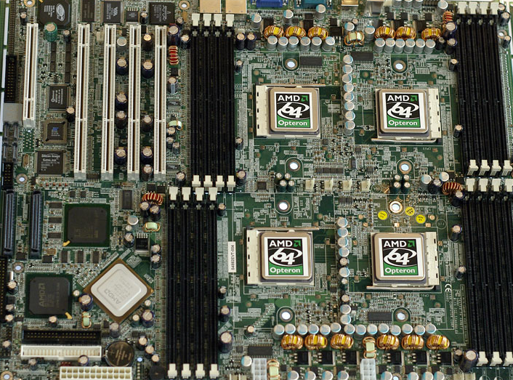
Example – Quad CPU Motherboard each with Multiple Cores.
Shared IO, but Local Memory (4 Dram slots per CPU for less bottleneck)

Slide 4
Arbiters for Main Memory
Arbiter/CPU operates as follows
One or more CPUs issue a bus request (BR_{x})
Arbiter issues a bus grant (BG_{x}) to the CPU with the highest priority
Other CPUs requesting use at the same time will have “wait states” introduced (via delayed Dtack’s) until they acquire the bus.
Once granted access, a cache controller can then read or write data from/to main memory.
At any point in time, the arbiter employs a MUX to connect one CPU to main memory.
Arbiter algorithms should strive to ensure fairness and avoid starvation by rotating CPU priorities with each access.
Dual CPU System
CPU #0
CPU #1
CPU
CPU
Dtack
Dtack
1 or more levels of cache
1 or more levels of cache
BG0
Clk
BG1
BR0
Dual Port Arbiter + MUX
BR1
CPU Memory Interface
Main Memory (Dram)

Slide 5
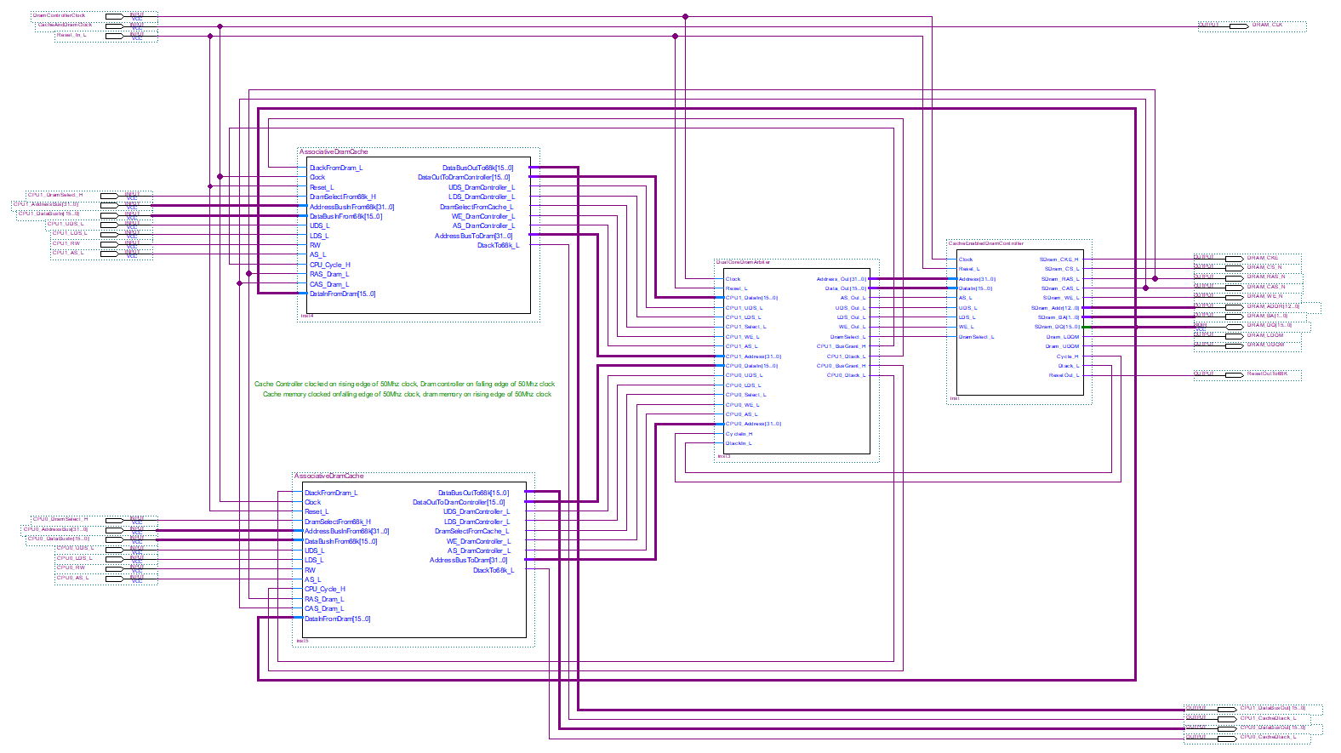
Dual Cache + Dual Port Arbiter + Single Port Dram Controller in a Dual CPU 68k System
Bus requests to arbiter are in the form of AS_L from each CPU coupled with an appropriate address
Dram Signals
CPU #1
CPU
Dual Port Arbiter and Mux
Single Port Dram Controller
CPU #1 Cache
CPU #0 Cache
CPU #0
CPU
Cache controller uses “CPU_Cycle_H” signal from Arbiter to indicate that data coming from Dram is for that cache. This signal is derived from Arbiter Bus Grant showing which Cache is accessing the Dram

Slide 6
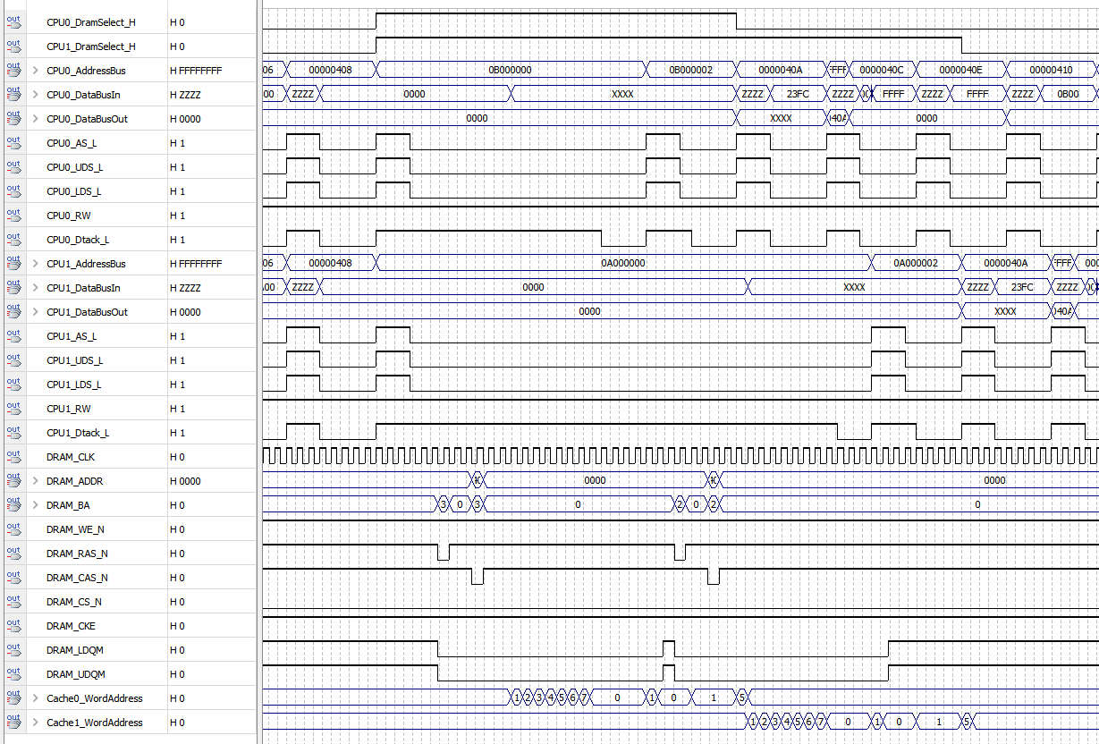
Dual CPU Simulation showing Effects of Arbitration in Concurrent Dram READ Access
68k access with arbitration takes 4 CPU clock cycles + 2 Arbitration clock periods = 5 CPU clocks
Burst read of 8 words of data to a cache shown below, takes 12 CPU clocks vs. 8 x 5 = 40 CPU clocks
Burst fills and caches create more bandwidth on the memory bus for other processors.
CPU 0 requests dram at same time as CPU 1. CPU 0 goes first with highest priority
CPU 0 gets to go first
CPU 1 forced to wait for CPU0 to complete
Dram accessed (CPU 0)
Dram accessed (CPU 1)
Cache CPU 0 line filled
Cache CPU 1 line filled

Slide 7
Distributed Arbitration (for IO) vs. Centralised Arbitration for IO
By having multiple arbiters, 1 per IO device, multiple CPUs can access different IO devices at the same time, leading to concurrent transactions and higher performance.
Such a scheme is common in FPGAs/ASICs where connections are not limited to a backplane or the number of wires.
CPU #0
CPU #1
CPU
CPU
Dual Port Arbiter
Dual Port Arbiter
Dual Port Arbiter
Dual Port Arbiter
Graphics
Disk
Timers & Parallel IO
Canbus

Slide 8
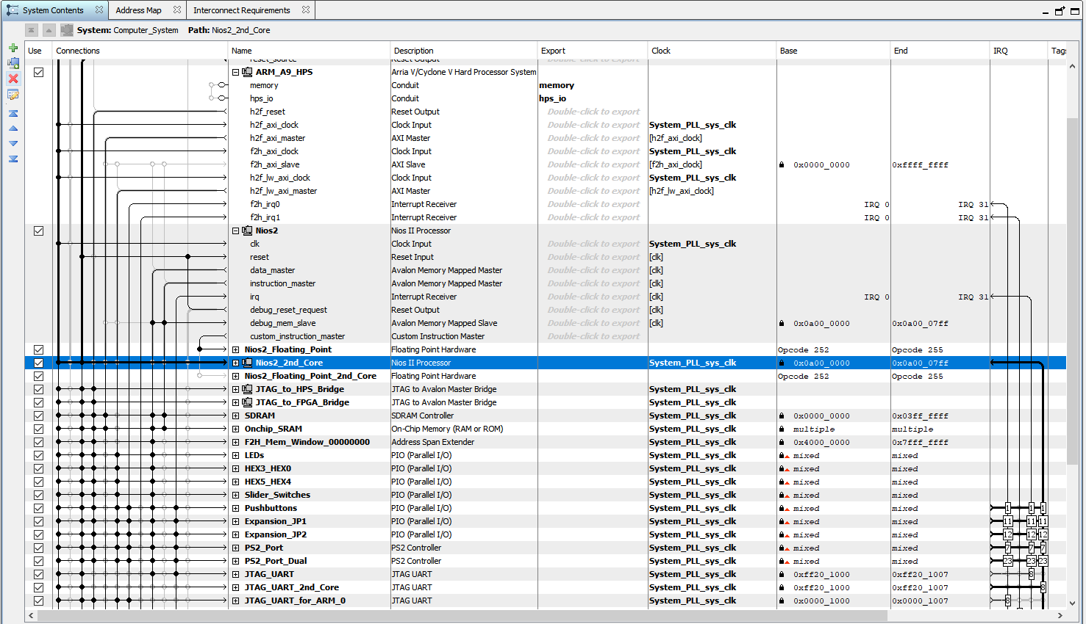
Use of advanced tools like Platform Designer/Qsys in Quartus can automate the generation of Multi-CPU Arbitration and Bus Mux logic as well as Address Decoder, Dtack generator and Interrupt Logic. Image below shows a system with Dual ARM and Dual NIOS Cores sharing access to Dram and IO devices, all via point-and-click configuration. Black “dots” represent connections between a CPU bus and a Memory/IO Device).

Slide 9
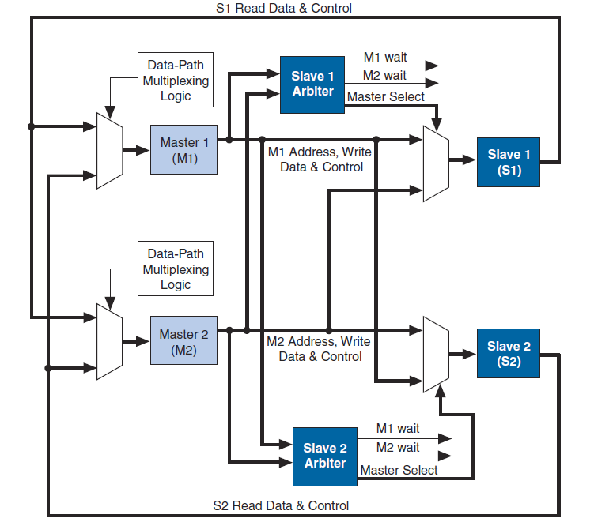
Dual Slave Side Arbiters generated automatically by Qsys for Altera’s Avalon Bus
Dual Channel Arbiter
Mux returns IO data to CPU
CPU0 Wait
CPU1 Wait
Mux connects 1 CPU bus to IO
CPU 0
Dual Slave IO devices
Dual CPUs
Mux connects 1 CPU bus to IO
CPU 1
Mux returns IO data to CPU
CPU0 Wait
CPU1 Wait
Dual Channel Arbiter

Slide 10
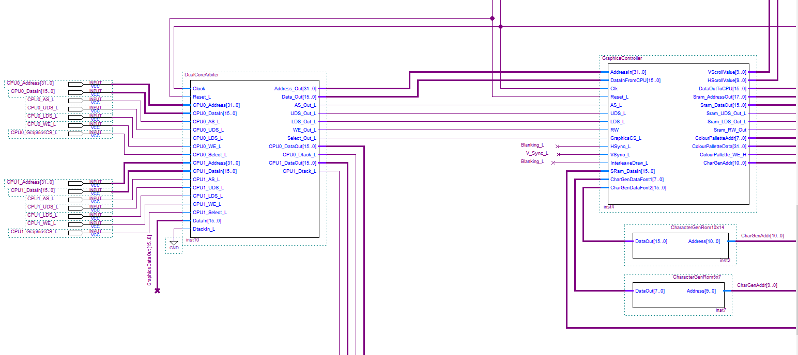
Dual Port Arbiter for Graphics Controller in a Dual CPU 68k System
CPU #0 Signals
Single Port Graphics Controller
Dual Port Arbiter + MUX
Arbiter out drives Graphics
CPU #1 Signals
CPU 0 and CPU 1 Data out and Dtack signals
Data In from Graphics fed back to CPU via arbiter during a read

Slide 11
Dual Port Prioritised Arbiter State Logic (VHDL). Note 2 IDLE States
-------------------------------------------------------------------------------------
-- Two main IDLE states depending upon rotating priority
-- In one state CPU 0 has top priority, in the other state CPU 1 has top priority
-- If both CPUs issue requests at the same time, the one with highest priority receives
-- a Bus Grant Signal : BG0_L or BG1_L for CPU 0 or 1 respectively. BRx comes from
-- AS_L on CPU and Address decoder output that selected Shared resource
-------------------------------------------------------------------------------------
if ( CurrentState = CPU0_Top_Priority) then -- Idle State 1
if ( BR0_L = '0') then -- Highest priority given to CPU 0
BG0_L <= '0'; -- CPU 0 receives Bus Grant Signal
NextState <= CPU0_Acknowledge; -- State to deal with CPU 0 transfer
elsif ( BR1_L = '0') then -- Lowest priority given to CPU 1
BG1_L <= '0'; -- CPU 1 receives Bus Grant Signal
NextState <= CPU1_Acknowledge; -- State to deal with CPU 1 transfer
end if;
elsif ( CurrentState = CPU1_Top_Priority) then -- Idle State 2
if ( BR1_L = '0') then -- Highest priority given to CPU 1
BG1_L <= '0'; -- CPU 1 receives Bus Grant Signal
NextState <= CPU1_Acknowledge; -- State to deal with CPU 1 transfer
elsif ( BR0_L = '0') then -- Lowest priority given to CPU 0
BG0_L <= '0'; -- CPU 0 receives Bus Grant Signal
NextState <= CPU0_Acknowledge; -- State to deal with CPU 0 transfer
end if;
Bus Grant (BGx) signals used to control Mux that connects CPUs to shared resources.

Slide 12
Re-arbitration and re-prioritization only occurs when the CPU that currently owns the bus, releases it.
------------------------------------------------------------------------------------
-- CPU 0 Termination State
------------------------------------------------------------------------------------
elsif( CurrentState = CPU0_Acknowledge) then -- wait for CPU 0 to end
BG0_L <= '0';
-- Using a MUX connect CPU0 signals to shared device
if ( BR0_L = '0') then -- if CPU 0 still active
NextState <= CPU0_Acknowledge; -- stay in this state
else
NextState <= CPU1_Top_Priority ; -- return to the idle state -- with CPU 1 now top priority
end if ;
------------------------------------------------------------------------------------
-- CPU 1 Termination State
------------------------------------------------------------------------------------
elsif ( CurrentState = CPU1_Acknowledge) then -- wait for CPU 1 to end
BG1_L <= '0';
-- Using a MUX connect CPU1 signals to shared device
if( BR1_L = '0') then -- if CPU 1 still active
NextState <= CPU1_Acknowledge; -- stay in this state
else
NextState <= CPU0_Top_Priority ; -- return to the idle state
-- with CPU 0 now top priority
end if ;
end if;

Slide 13
Mutual Exclusion in Multiple CPU Systems

Slide 14
Multiple CPU Mutual Exclusion for IO Devices
Although arbiters can ensure that only 1 CPU is allowed to read or write to a device at any instant. They do not provide a means for a CPU to lock/unlock an IO device for longer than 1 bus cycle, thus a CPU performing multiple transactions on an IO device or memory risks losing control of it when each transaction completes. This can be problematic.
Example
Consider 2 CPU’s drawing a shape by reading the status of a graphics chip (waiting for idle)
Writing information to the, X, Y, Colour and Command registers of the graphics.
Both CPUs could alternately read the graphics status reg (using arbitration), both see it as idle and, through interleaved/arbitrated writes, both attempt to draw a shape at same time.
CPU #0
CPU #1
Miscellaneous
Miscellaneous
Miscellaneous
Miscellaneous
Read Status (Idle)
Status
Status
Read Status (Idle)
Read value of a (0)
Read value of a (0)
Set X,Y Colour
Parameters
Graphics Chip
Parameters
Set X,Y Colour
Add 1 to value (1)
Add 1 to value (1)
Draw Rectangle
Command
Draw Circle
Store back a (1)
Command
Store back a (1)
With arbitration on an access by access basis, what Shape gets drawn and where?

Slide 15
Locking a Resource for Multiple Transactions
The solution to locking a resource for multiple transactions lies with the use a “flag” variable in memory which indicates if the resource is free or busy.
Here, all CPUs attempt to acquire/lock the resource by executing a specialised CPU instruction, designed to enforce synchronisation between CPU’s.
That instruction tests and sets the flag as one indivisible/atomic operation.
That is, it performs a read-modify-write of the flag without releasing control of the memory location. This prevents the arbiter from handing control of the flag to another CPU to test and set at the same time.
On the 68k family of CPUs (a processor designed for use in multiple CPU environments), that assembly language instruction is TAS which implements the “Test-and-Set” protocol. This instruction is at the heart of Mutexes and Semaphores in concurrent systems/OS theory. (see http://en.wikipedia.org/wiki/Test-and-set).

Slide 16
The “Test and Set” Instruction (used on 68k and other CPUs)
TAS reads a memory location and writes back a ‘1’ with one memory access.
The program is returned the original value of the flag before it was set to ‘1’
While this is taking place, AS_L is held low throughout the instruction to prevent re-arbitration between the read and the write operation.
Typically TAS will take twice as many clock cycles to execute as a normal read or write. (see https://en.wikipedia.org/wiki/Read-modify-write )
Note : The Intel x86 family (i.e.. i3/i5/i7 etc has a compare and exchange instruction CMPXCHG which works slightly differently but achieves the same result.
Note also: ARM family processors have the SWP (swap) and SWPB (swap byte) instructions to swap registers with a memory location on their A5 processors for example. This can be used to achieve the same result as TAS.

Slide 17
Note: Simply Reading a flag followed by a separate instruction to write to it doesn’t work in a multiple CPU system, as re-arbitration could occur between the read and the write allowing two CPUs to both read the resource as free, then both mark it as busy.
Re-arbitration after simple “read” allows CPU 0 & 1 to both see flag as free
CPU 0
e.g. 10nS
Tests Result
e.g. 10nS
Address
Read
Write
R/W Signal
1
0
Access Graphics
Data In
0 (Free)
Data Out
1 (Busy)
CPU 1
e.g. 10nS
e.g. 10nS
Tests Result
Address
Read
Write
R/W Signal
1
0
Access Graphics
Data In
0 (Free)
Data Out
1 (Busy)

Slide 18
With a TAS instruction, the flag access timing looks like this. Worst case both CPUs “TAS” together. Hardware arbitration ensures only highest priority CPU gains access to the flag at that time. TAS reads then writes as one bus-cycle preventing re-arbitration.
CPU 0
CPU 0 “locks” memory for full TAS
TAS takes twice as long e.g. 20ns
CPU 0 “releases flag”
Address Bus
Read/Write
Write
R/W Signal
1
0
Access Graphics
0
Data In
0 (Free)
Data Out
1 (Busy)
0 (Free)
CPU 1
CPU 1 tries TAS at same time as CPU0 – Arbiter gives memory to CPU 0
Address Bus
Read/Write
Read/Write
CPU 2 has to wait for CPU 1 to complete
R/W Signal
1
0
1
0
Access Graphics
Data In
1 (Busy)
0 (Free)
Data Out
1 (Busy)
1 (Busy)

Slide 19
How do we use TAS to lock a resource?
If TAS returned 0, your program will know that the resource was free when your CPU executed TAS. Furthermore, TAS will now have marked the resource as busy (by setting the flag to 1) and it is now locked for you, for as long as you want it.
If TAS returned 1, your program will know that the resource was already in use by another CPU and thus you will have to try TAS again later. Note that in this case, the act of setting the flag to 1 above will be harmless since it was already 1 due to the resource being in use by another CPU.
IMPORTANT: Once a CPU has finished with the resource, it must remember to clear the flag back to 0 to release/unlock the resource for other CPUs. All programs must remember to use this protocol to lock/unlock the resource.

Slide 20
Case 1: Resource Busy
Location $10000
TAS $10000
Resource
CPU 1
Repeat until acquired resource
CPU 1
flag is Busy
Must wait
CPU 1
1: Read (Busy)
Flag = Busy
IO or Memory
2: Write (Busy)
Case 2: Resource Free
Location $10000
TAS $10000
Resource
1: Read (Free)
CPU 1
flag as Free
Flag = Busy
CPU 1
Flag = Free
Flag = Free
IO or Memory
2: Write (Busy)
4: Write (Free)
3: Access Resource

Slide 21
Gaining Entry to a Resource using TAS
You could include the following assembly language code into your programs to acquire and lock the resource by looping on the flag variable while is it zero
loop: TAS $10000 Test and set a flag variable at location hex 10000
bne loop branch if read flag not equal to 0 (i.e. was 1) i.e. busy
..... Locked resource. I can do what I like with it now
….. wait for graphics chip, write colour, x, y, shape etc
clr.b $10000 Clear the flag to release the resource (free)
This code could be wrapped into a function if required (see test_and_set() function in C++ ‘11).
Looping while testing a flag is known as a busy-waiting loop or spin-lock .
Wasteful of CPU time.
Possibility of starvation and non-deterministic program behaviour.
Busy-waiting or Spin Lock

Slide 22
What if the processor doesn’t support something like TAS?
Not all processors that end up being used in multiple CPU systems support a TAS like instruction. Altera’s NIOS II for example does not have it, or any equivalent read-modify-write instruction.
All is not lost however. For those processors, we can implement a TAS like operation on a hardware variable (i.e. a “H/W mutex”).
Altera implements a “H/W mutex” as a simple IO device that updates it’s own state based on read/write actions performed on it.
A separate H/W mutex could thus be created for each IO device in the system that is shared by more than one CPU.
An arbiter will be needed to ensure only 1 CPU accesses the mutex at a time.

Slide 23
Multiple Hardware Mutexes – 1 per shared IO device
Each mutex used to lock each resource/IO Device
CPU #0
CPU #1
CPU
CPU
Dual Port Arbiter
Dual Port Arbiter
Dual Port Arbiter
Dual Port Arbiter
Graphics
Disk
Timers & Parallel IO
Canbus
Mutex
Mutex
Mutex
Mutex

Slide 24
Altera Hardware Mutex
The Mutex is a 16 bit register that is cleared on reset.
The register is split into 2 single byte wide fields:
Bits [15..8] represent the ID of the CPU that has locked/owns the resource.
Bits [7..0] represent the Mutex Value - “0” means resource is free, otherwise it is busy. Technically only 1 bit is required for mutual exclusion, but it may be possible to use the other bits to implement some kind of counting semaphore for example.
Operation
A CPU tries to acquire/lock the resource by writing it’s own ID and ‘1’ to the Mutex register.
The mutex will only store a new value if the resource is currently free (i.e. bits[7..0] = 0), or the CPU ID being written matches the one currently stored in the mutex bits [15..8]
Thus there is no guarantee that this acquisition/lock will be successful if the resource is in use by another CPU.
To test if the acquisition was successful (after writing) the CPU has to read back the 16 bit mutex and check that it is now the same 16 bit value that it just wrote.

Slide 25
Example H/W Mutex Operation for a Graphics Chip
Assume we added a Hardware Graphics Mutex to our design in Quartus and assigned it an address e.g. hex 0060 0000
#define GraphicsMutex *(volatile unsigned short int *)(0x00600000)
The algorithm to acquire, use and eventually release the graphics would look like this
// repeatedly try to acquire Graphics Mutex using spinlock until successful.
// Assume it is CPU 2 attempting this operation and wants to set mutex to busy
do {
GraphicsMutex = 0x0201; // set CPU ID = 02 and BUSY = 01
} while( GraphicsMutex != 0x0201) ; // repeat until acquire successful
// CPU has successfully acquired the mutex, so can use the graphics
...
...
// must remember to release the graphics for use by another CPU
GraphicsMutex = 0x0000; // Only CPU 2 can release the mutex

Slide 26
-- if the Mutex is being addressed and written to by the CPU
if( MutexSelect_H == 1 && WE_L == 0 ) begin
-- if the value of the Mutex is 0 OR
-- the CPU ID stored in the Mutex matches that of the CPU writing to the Mutex
if(( TheMutex[7:0] == 8’b00000000 ) ||
( TheMutex[15:8] == DataIn[15:8] )) begin
-- store the 16 bit value written by the CPU
TheMutex = DataIn ;
end
-- otherwise Mutex value and CPU ID is NOT changed
end
H/W Mutex Implementation in Verilog

Slide 27
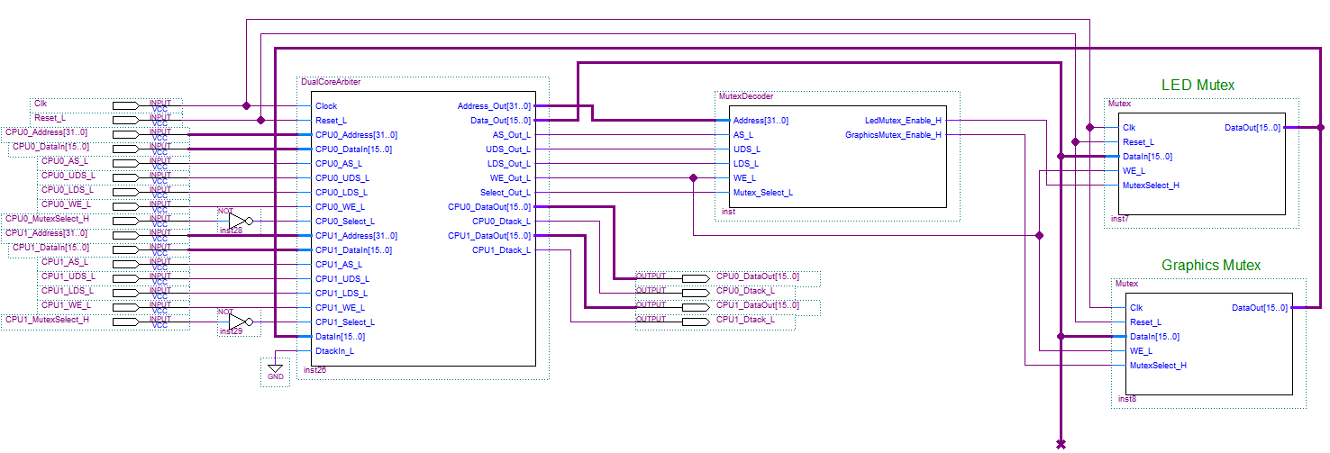
In the illustration below, used in a dual CPU 68k system, all the IO mutex’s have been grouped together in one place (for simplicity) with a single dual port arbiter.
We can add as many mutexes as we like to this circuit – 1 per IO device in system.

Slide 28
Interprocess Communication and Memory Coherency in Multiple CPU Systems

Slide 29
Multiple CPU systems often use shared memory as a means of achieving inter-process communication, i.e. exchanging data, but when those CPUs have their own caches it creates problems.
For communication to work, all CPUs must see the same data at the same time.
With caches, a CPU read or write of a variable in Dram may or may not involve the use of the main memory (see cache write policy - last lecture). For example one CPU may read an item from its cache which could be “stale” if it has been updated in main memory or written only to the cache of a 2nd CPU.
CPU0
CPU1
CPU2
CPU
CPU
CPU
1 or more levels of cache
1 or more levels of cache
1 or more levels of cache
Main Memory (Dram)
Centralised Shared Memory

Slide 30
Problem: Consider the following sequence of processor reads/writes.
Let’s assume the caches use a write-back policy (i.e. main memory only updated/written to when cache data is evicted).
T₃: Increment A
T₅: Load A
T₂: Load A
T₁: Load A
T₄: Load A
CPU #0
CPU #1
CPU #2
CPU
CPU
CPU
Cache
A Not Cached
A Not Cached
A Not Cached
A = 1
A = 1
Cache
A = 1
Cache
A = 2
CPU Reads Stale Value from Cache
CPU Reads Stale Value from memory
‘A’ in cache has become
Stale
‘A’ not written back to main memory
‘A’ = 1
‘A’ in main memory has become Stale
Main Memory (Dram)

Slide 31
The problem is not solved even with a write-around or write-through cache.
T₃: Increment A
T₅: Load A
T₂: Load A
T₁: Load A
T₄: Load A
CPU #0
CPU #1
CPU #2
CPU
CPU
CPU
Cache
A Not Cached
A Not Cached
A Not Cached
A = 1
A = 1
Cache
A = 2
Cache
A = 2
CPU Reads Stale Value from Cache
Correct Value read
‘A’ in cache has become
Stale
Write Back
‘A’ = 1
‘A’ = 2
Main Memory (Dram)

Slide 32
What about Multi-Core Systems?
The same problem also occurs here, for the same reasons. Each core may have it’s own level 1 cache inside the CPU whose data could become stale.
However, because those caches are inside a single CPU it’s possible for the caches to communicate through extra logic/wires an approach not necessarily possible between multiple CPUs (as more external pins would be needed)
Multi-Core Cache Coherence Protocols
Caches inside the same CPU can communicate and keep track of which CPUs have copies of shared data in their Cache.
Ensure that at any given time only a single value for data exists in all caches.
This can be achieved by two means.
Invalidating any Stale data
Updating everyone’s copy when data changes
Either approach increases cache controller complexity considerably.
https://en.wikipedia.org/wiki/Cache_coherence

Slide 33
Invalidating Approach: Let’s assume a Write-Back Cache (data written on eviction)
Note : A Cache only supplies data to another cache if it has a “modified” copy of the data being requested by the other cache (i.e. different to that stored in main memory).
This is why Cores 0 and 1 get their values for ‘A’ from Core 2 because Core 2 holds a modified copy. Invalidating approach cuts down on Dram traffic.
T₅: Load A
T₁: Load A
T₄: Load A
T₆: A evicted
T₂: Load A
T₃: Increment A
Core#0
Core#1
CPU
CPU
Core#2
CPU
Invalidate ‘A’
Cache
Cache
Cache
A Not Cached
A Not Cached
Cache #2 “Snoops” Read request from Core 1 and supplies up-to-date ‘A’
A Not Cached
A = 2
A = 1
A = 2
A = 1
A = 2
Invalidate ‘A’
Cache #2 “Snoops” Read request from Core 0 and supplies up-to-data ‘A’
A = 1
A = 2
Stale
CPU #2 writes ‘A’ to Main Memory
Main Memory (Dram)

Slide 34
Updating Approach: Assume a Write-Through Cache (data written when it changes)
All caches snoop the main memory bus looking for data writes by another cache. If they have that data, they update/grab a copy of it
Updating increases Dram Traffic compared to Invalidating. Hence Invalidating is the more commonly used technique, particularly in tightly coupled caches (e.g. Cores on the same CPU “die”).
T₅: Load A
T₁: Load A
T₄: Load A
T₂: Load A
T₃: Increment A
Core#0
Core#1
Core#2
CPU
CPU
CPU
A Not Cached
A Not Cached
A Not Cached
A = 2
Cache
A = 1
A = 1
Cache
A = 2
Cache
A = 2
Use Cached Value
Core #0 Snoops Write and Updates ‘A’
Core #2 Updates ‘A’ in Main Memory
A = 1
A = 2
Main Memory (Dram)

Slide 35
Data Cache Problems : IO Device Accesses
Data Caches present a problem when reading/writing to IO devices.
Imagine you have a pointer to an 8 bit Parallel port with 8 attached switches.
Your program loops waiting for, say, hex 55 on the switches.
It fails due to the CPU “caching” the previously read switch value.
Likewise a write to a parallel LED port for example might not happen immediately if the write policy means data was written only to the cache (it will only be written to the port when the data it is evicted).
int main(void)
{
char *switches = (volatile char *)0x00002000;
while(*switches != 0x55)
;
printf(“Hex 55 found on switches\n”);
return 0;
}
Loop Fails: First read of “switches” is cached and subsequent iterations of the loop use the cached value ignoring switch changes in real world.

Slide 36
General Solution Cache By-passing: Read and Write Operations
Many micro controllers whose caches are not so tightly coupled as they are in multi-core CPUs, have instructions designed to “bypass” the data cache entirely and lead to genuine read and write accesses to memory and IO devices each and every time.
In the NIOS II cache, read/write bypassing is achieved with the instructions LDIO and STIO. Great for assembly language programmers, not so helpful if writing in ‘C’.
NIOS II also supports A31 cache bypassing. That is, any read or write to an address with A31 = 1, will bypass the data cache but physically map to the same address as if A31 were equal to 0. That is, a read from address 0x81002000 is equivalent to an write to 0x01002000 except the former bypasses the cache, the latter could use the cache.
Using this 2nd technique within ‘C’ would allow “pointer” accesses to memory and IO device to bypass the cache and issue genuine reads/writes.
Processor 1 Processor 2
char *data = 0x81002000; char *data = 0x81002000;
*data = 0x55; x = *data;
Write by-passes data cache and always writes directly to main memory
Read by-passes data cache and always reads directly from main memory

Slide 37
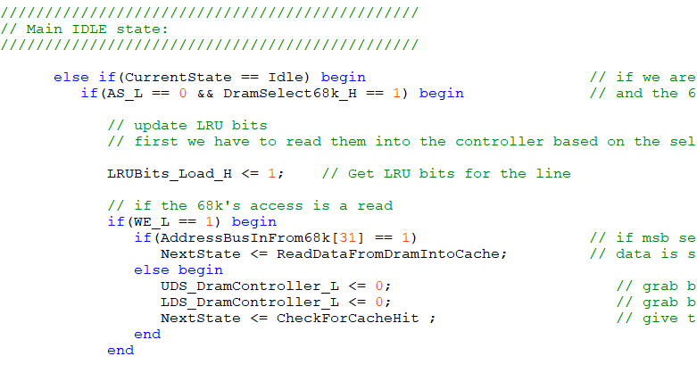
You can see the A31 cache by-pass technique applied in the design of a cache controller used in our multiple 68k system.
Note our 68k cache does not cache writes anyway, so writes were always bypassed.
The “tweak” below is to ensure reads also bypass the cache (when A31 = 1) and load from physical memory or IO devices regardless of hit/miss.
Another technique might be to modify the cache controller so that regions/block of the address space can be programmed to “never cache”.
Get data from Dram if A31 = 1
Otherwise look in Cache 1st

